Slide 1
Internship Overview
DB RFT Delivery Support
Anurag Lashkare
2025
Internship Program
Final Presentation
Focus: Dashboarding, Automation & Bot Development

Slide 2



Team & Mentorship
Guided by Excellence
Prateek Asthana
Jatin Verma
Primary Mentor
Secondary Mentor
Guided technical architecture and project direction
Provided strategic insights and feedback loops

Slide 3



Major Contributions
Key Projects Delivered
Excel Dashboard
MS Teams Bot
Resume Formatter
Interactive candidate tracking system with advanced functions and real-time updates
Prototype bot for automated reminders and myTE follow-ups integration
Automated tool: upload raw text → get clean formatted resume. Live demo ready

Slide 4
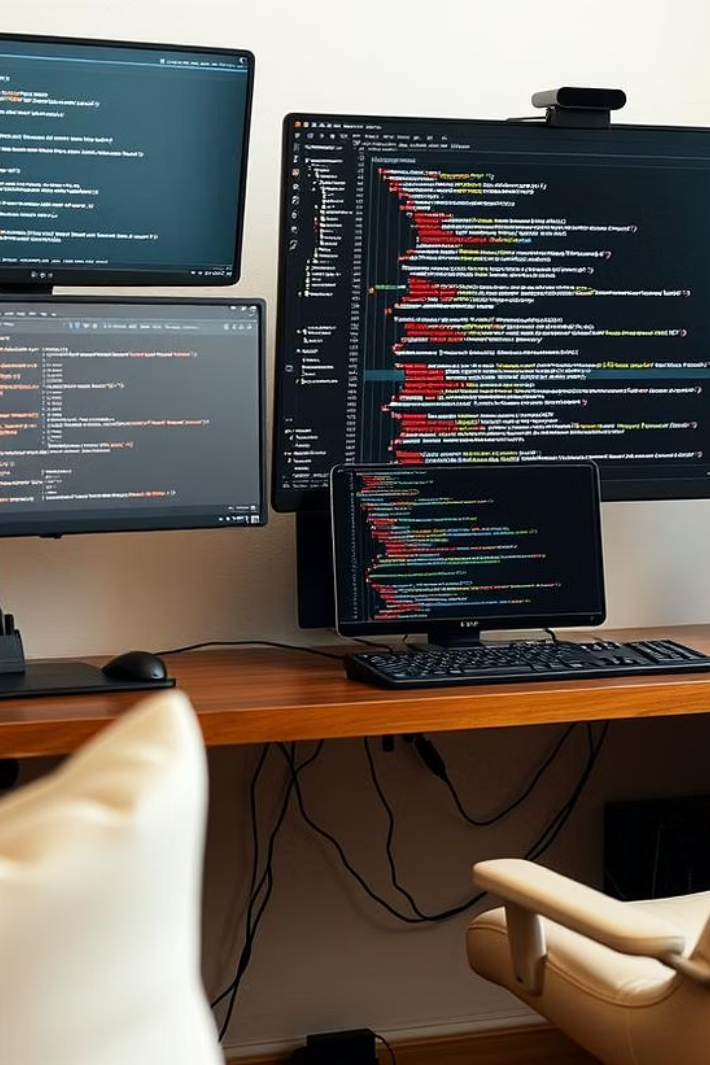
Technical Learning
Tools & Technologies
Frontend Development
HTML, CSS, JavaScript for responsive web interfaces
Backend Integration
Node.js, Microsoft Bot Framework for Teams integration
AI & Advanced Excel
Google Gemini API integration, advanced Excel functions and dashboards

Slide 5
Problem Solving
Challenges & Solutions
Privacy Concerns
Dynamic Templates
Challenge: Gemini API privacy issues
Challenge: Supporting multiple resume formats
Solution: Transitioning to Local LLM implementation
Solution: Developed modular template logic
Teams Integration
Time Constraints
Challenge: Complex bot framework learning
Challenge: 5-week delivery timeline
Solution: Leveraged documentation and AI assistance
Solution: Prioritized core features, iterative development

Slide 6
Deep Dive
Resume Formatter Tool
Core Features
Technical Architecture
Automated text parsing and structuring
Frontend: HTML/CSS/JavaScript
Clean, professional formatting
Backend: Flask, Python
Extensible template system
AI Integration: Google Gemini API
Web-to-desktop migration in progress
Future: Local LLM implementation
Live demo available for presentation

Slide 7

Key Innovation Ideas Overview
AI-Powered Contract Analysis Automates legal reviews, flags risks — saves 70% review time.
Smart Support Ticket Routing ML routes tickets to right agents — boosts resolution speed by 50%.
Predictive Maintenance via IoT Prevents machine failures using sensor data — cuts downtime by 30%.
Automated Financial Reconciliation AI matches transactions across systems — 80% faster and error-free.
Dynamic Pricing Optimization Real-time AI pricing in e-commerce — increases revenue by 15–25%.

Slide 8



Reflection & Growth
Key Takeaways
Feedback Integration
Delivery Focus
Continuous Learning
Learned to transform mentor feedback into actionable product features
Successfully delivered functional Resume Formatter with extensibility
Adapted to new frameworks and technologies throughout the internship

Slide 9
Looking Forward
Next Steps
Immediate Goals
Career Aspirations
Complete desktop version of Resume Formatter
Continue contributing to DB RFT projects
Implement Local LLM for enhanced privacy
Explore PPO opportunity
Refine MS Teams bot functionality
Expand automation and AI integration skills
Ready to take on new challenges and contribute meaningfully to the team's success

